Slide 1



Kardar-Parisi-Zhang Scaling in Time-Crystalline Matter
Daviet R et al. Physical Review Letters, 2025, 135(4): 047101.
曹溪能

Slide 2
abstract
Forming a continuous-time crystal leads to spontaneous symmetry breaking of time-translation invariance, generating a massless Goldstone mode.
Question: What is the Goldstone mode? what properties it has?
Answer: The Goldstone mode is an angular variable which belongs to KPZ universal class.

Slide 3
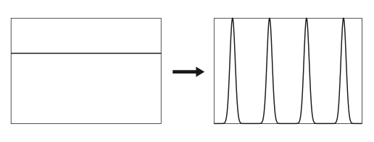

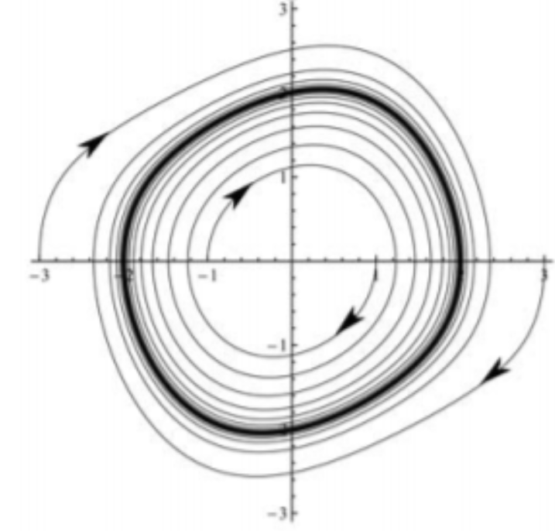
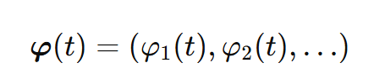
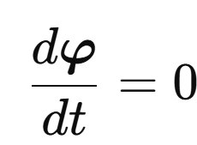
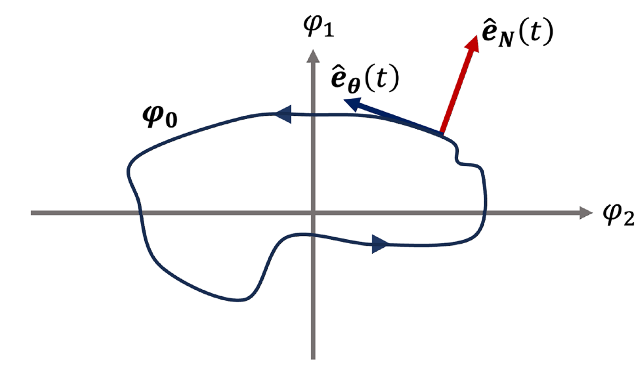
continuous time crystal(CTC)
coarse-grained order parameter
is time-periodic with minimal period T
definition:
perspective in order parameter phase space：limit cycle
CTC = limit cycle
no-go theorem:CTC cannot exist in equilibrium,can only in non-equillibrium
perspective in order parameter phase space
equilibrium state（ ）
：fixed point in phase space，not limit cycle

Slide 4
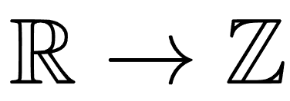
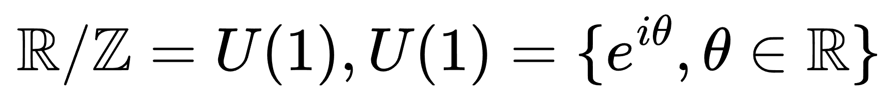
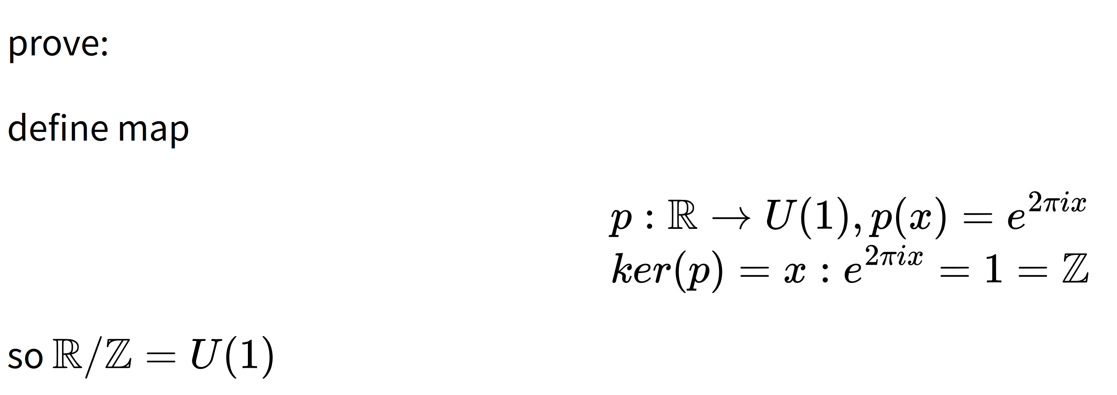
goldstone mode(chronon)
group theory perspective:
time-translation invariance spontaneous symmetry break from continuous to discrete
goldstone mode’s symmetry:
goldstone mode is an angular variable

Slide 5
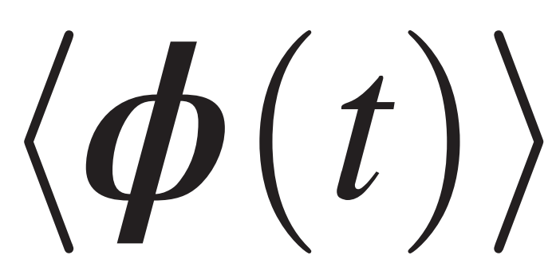
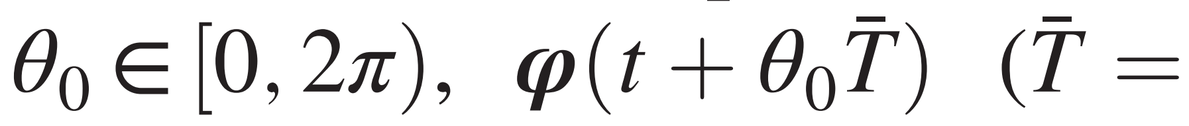
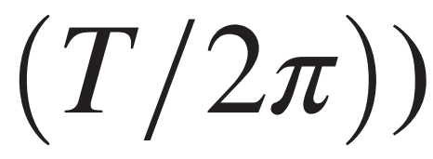
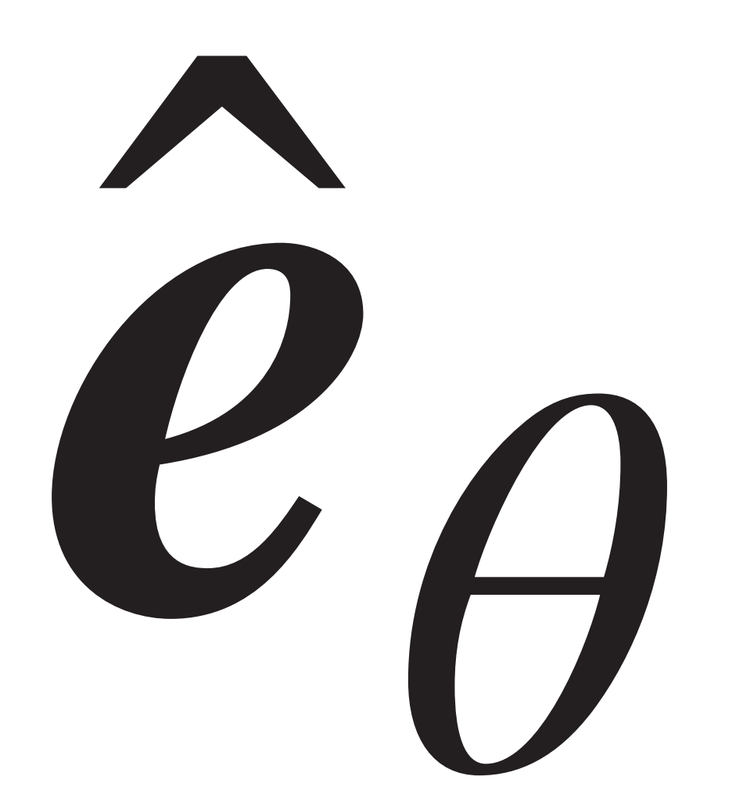

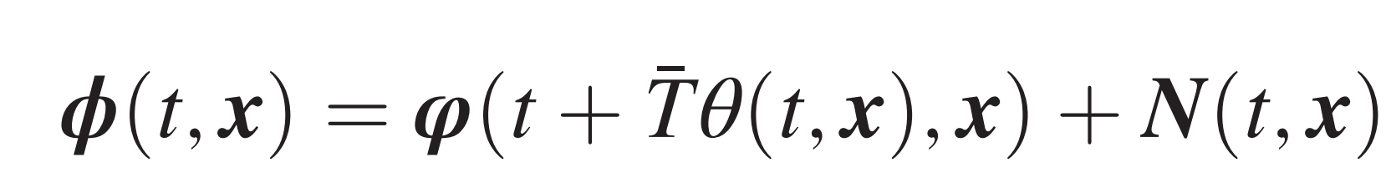
goldstone mode(chronon)
phase space perspective:
traces out a one-dimensional closed orbit with period T, which can be parametrized by an angular variable
fluctuation along is gapless (goldstone mode),perpendicular is gapped
which fluctuates on timescales much larger than T
dynamic expression:
goldstone mode “chronon”

Slide 6
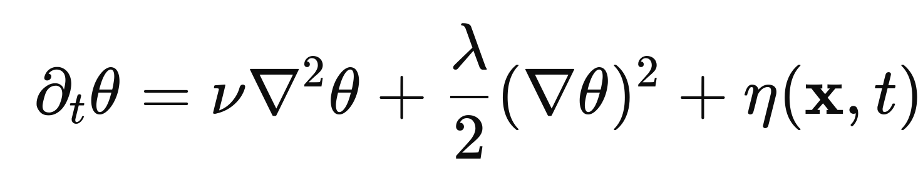
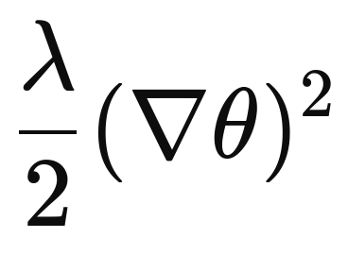
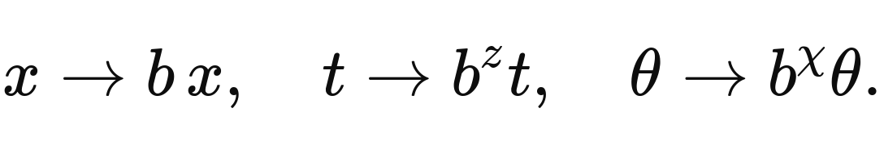
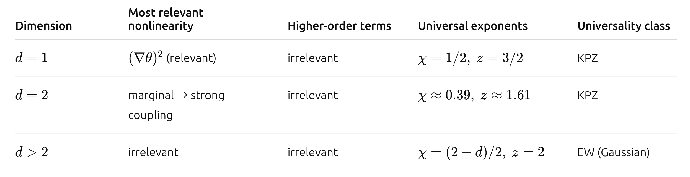
effective field theory for chronon
kpz
break detailed balance
scaling

Slide 7
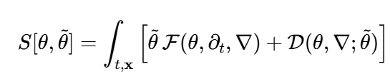




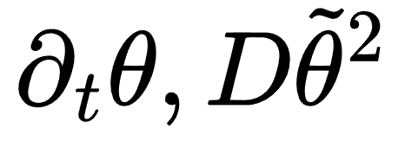

effective field theory for chronon
process: write down an action including all terms ,then drop those prohibited/irrelevant terms
maximum MSRJD action:
drop prohibited/irrelevant terms
translation symmetry: keep invariant under
forbbiden terms with undifferentiated 𝜃,like
spatical isotropic: rotation symetry
forbidden Anisotropic,forbidden terms like
Markovianity: long time/wave limit,time/space scale far exceeds that of the memory core. only allow first-order time derivative and white noise:
broken detailed balance: allow nonlinear terms like

Slide 8
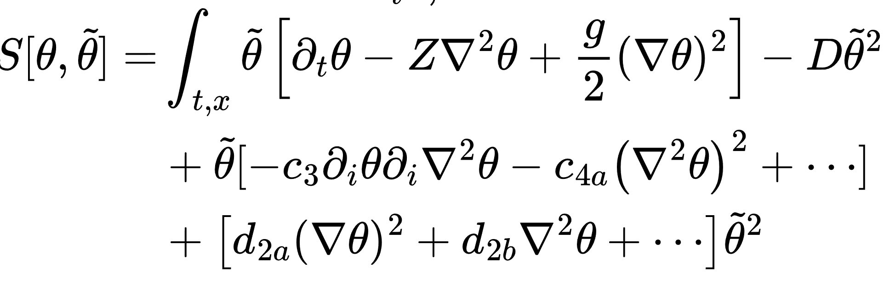
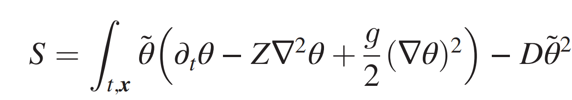
effective field theory for chronon
simlified actions
high order terms,irrelevent
final action: compact kpz

Slide 9
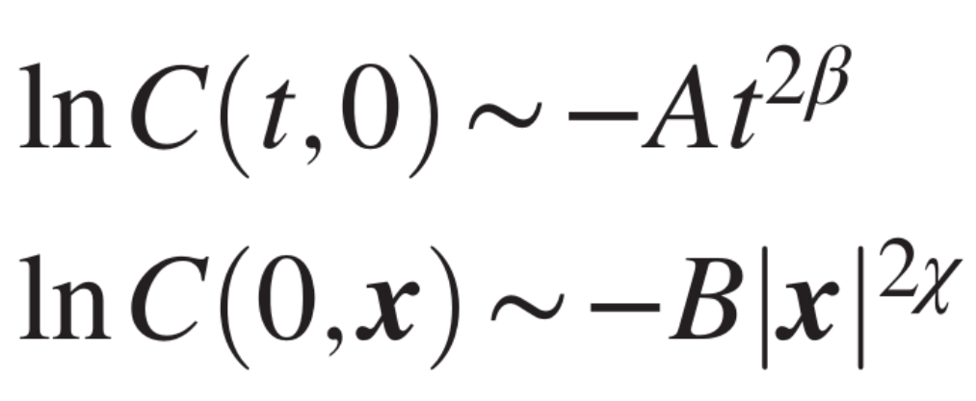
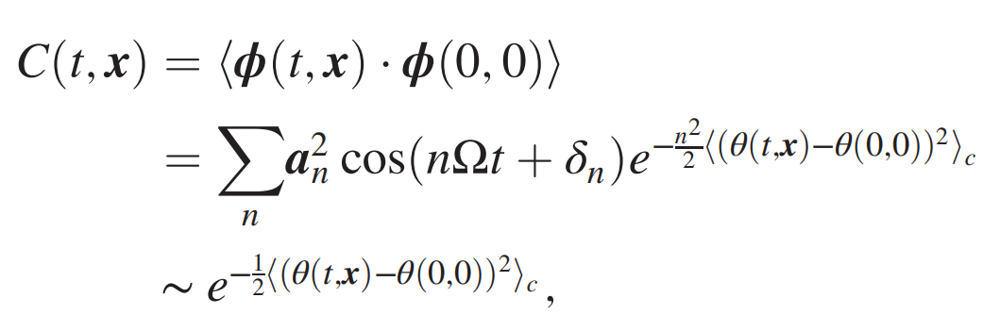
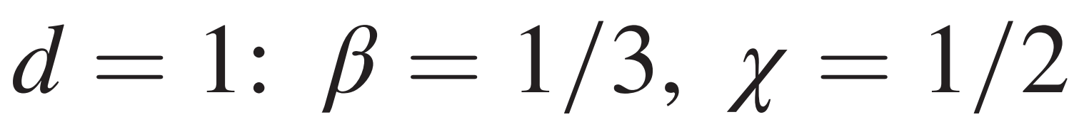
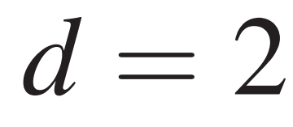
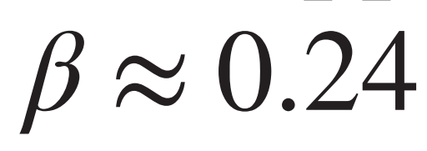
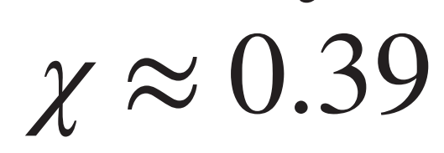
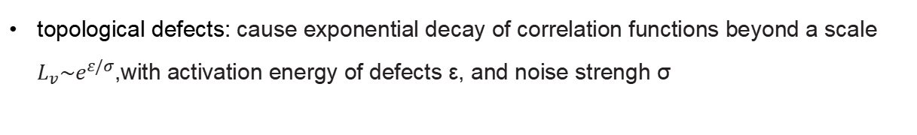
scaling predictions
chronon belong to compact kpz university class
scaling exponent:
topological defects: cause exponential decay of correlation functions beyond a scale $L_{v}\sim e^{ε/σ}$,with activation energy of defects ε, and noise strengh σ

Slide 10
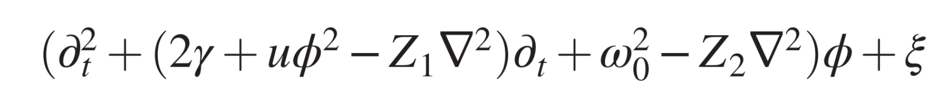
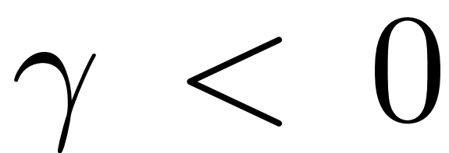
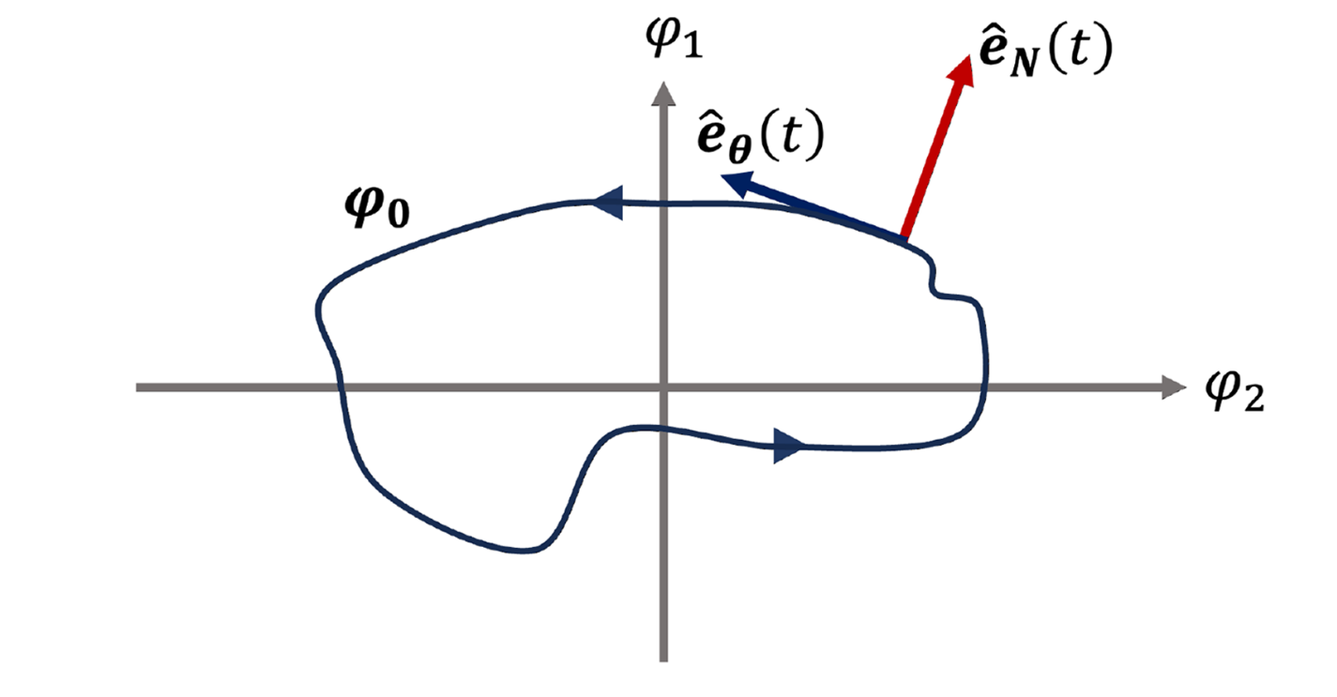
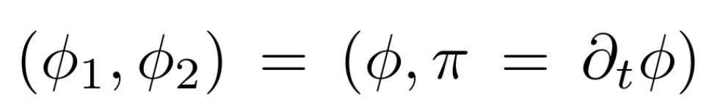
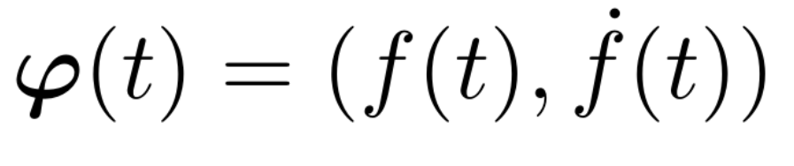
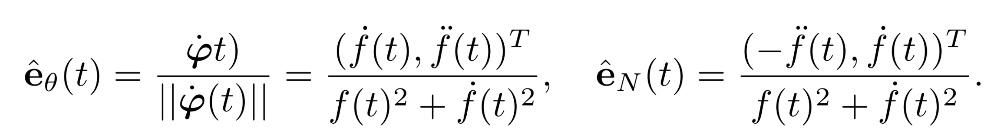
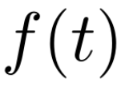
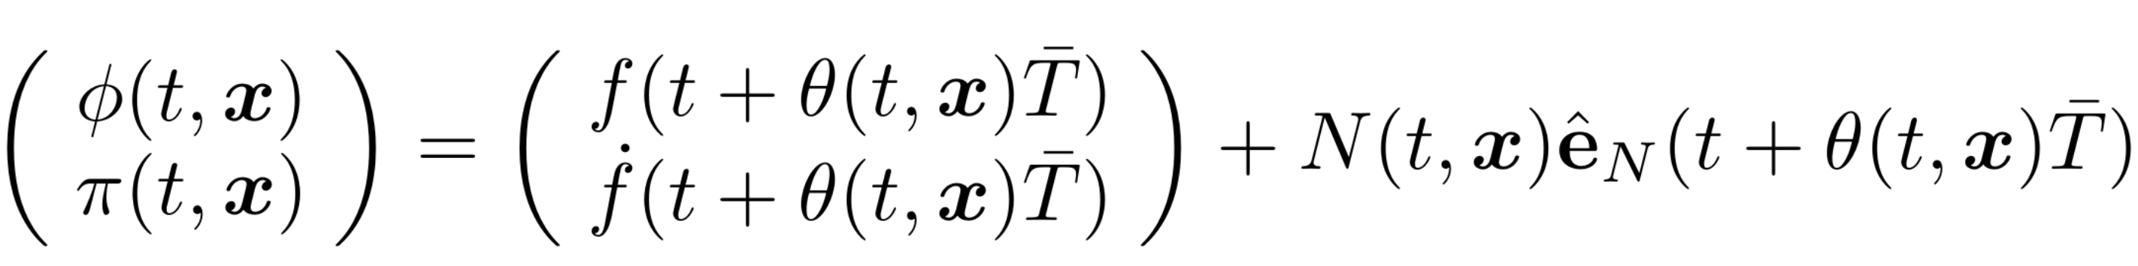
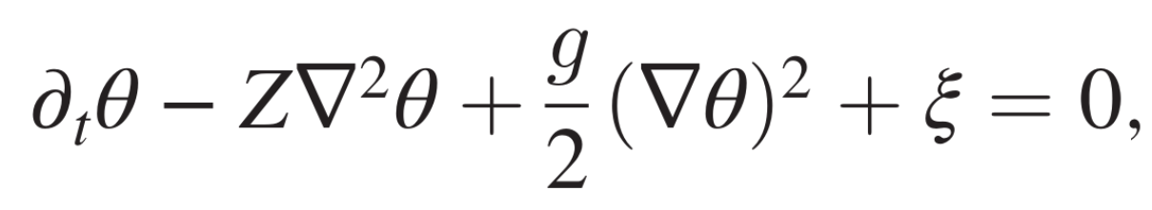
Chronons in the many-body Van der Pol system
dynamic equation:
CTC phase condition:
phase space:
reparameter limit cycle
insert it into dynamic equation
Integrate out the gapped mode and average over time

Slide 11
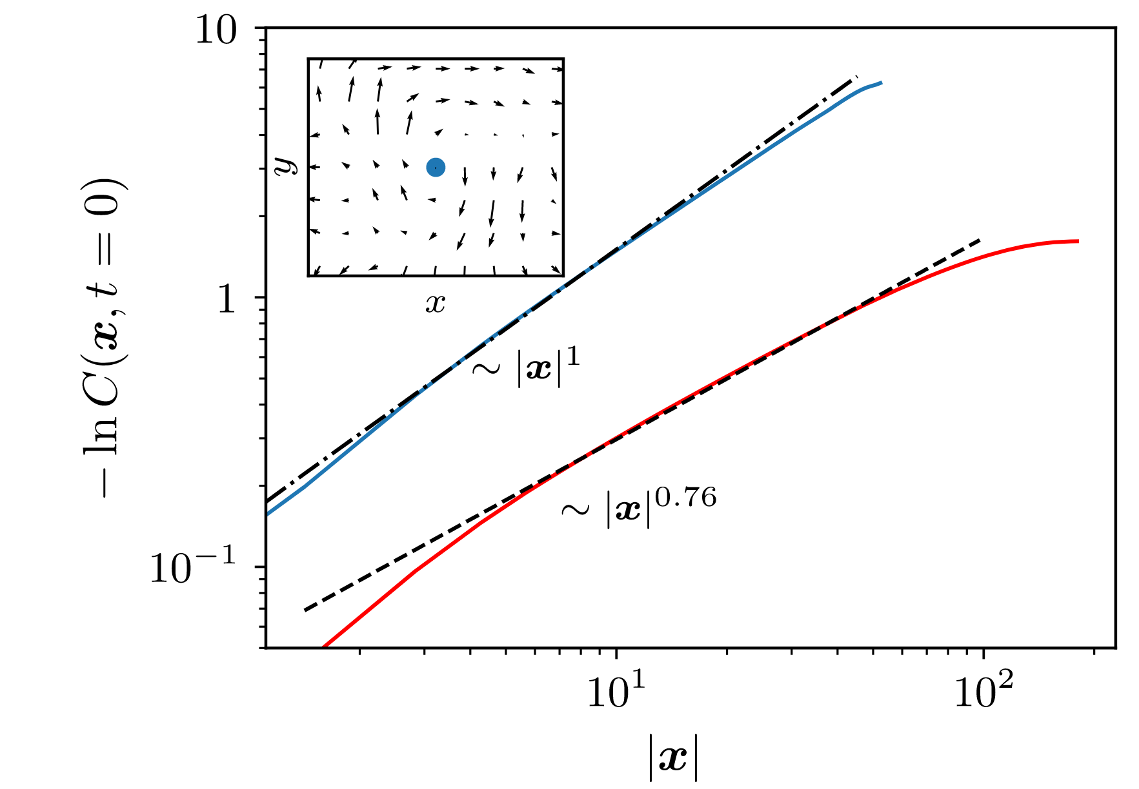
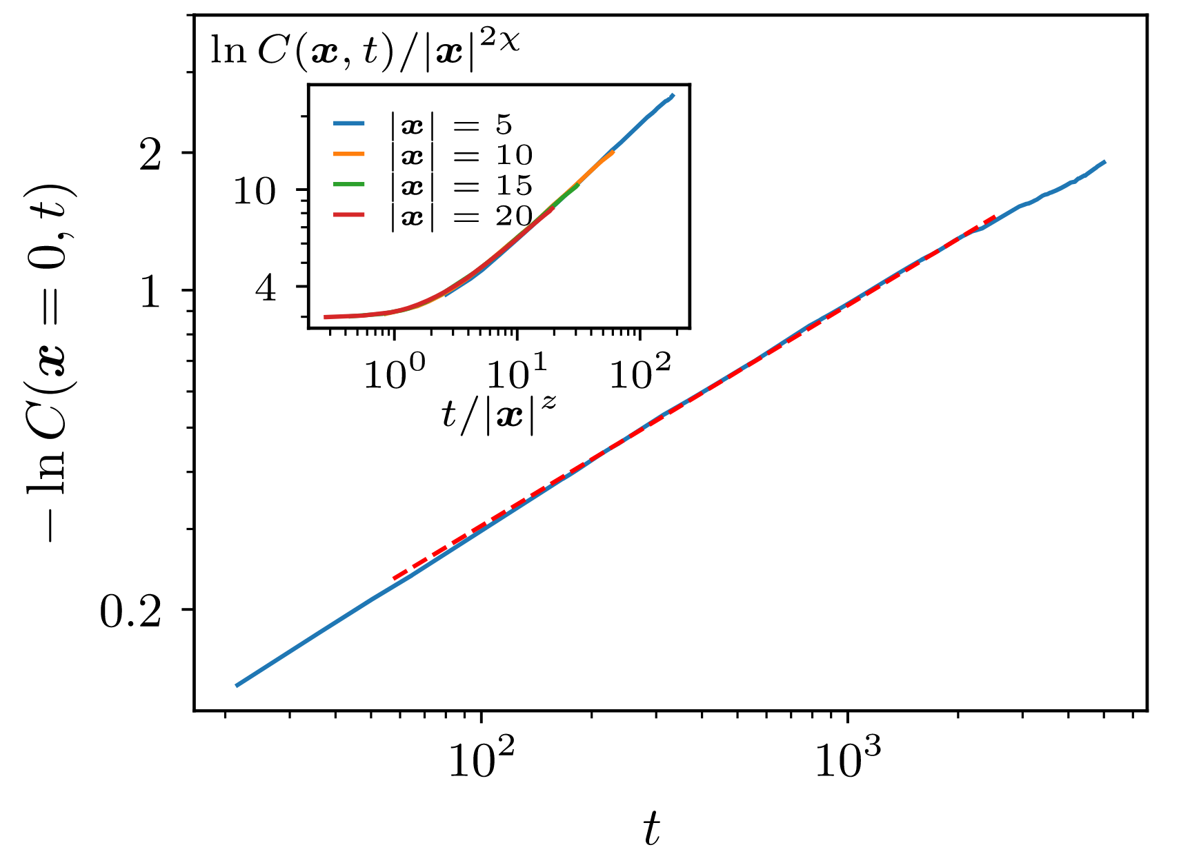
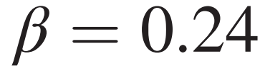
Chronons in the many-body Van der Pol system
blue: high noise
red: low noise
2d kpz:β≈0.24,χ≈0.39

Slide 12
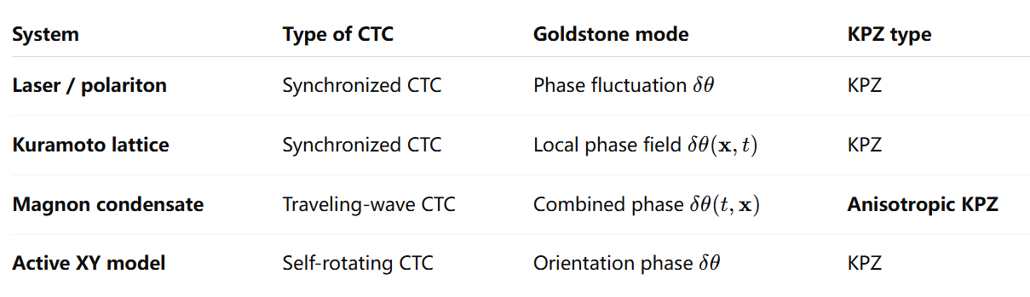
Chronons in various systems

Slide 13
conclusion and outlook
conclusion:the goldstone mode “chronon” of continuous time crystal belong to kpz university class
outlook: additional conserved quantities or the couplings to other soft modes may give rise to new universal behaviors.

